Slide 1
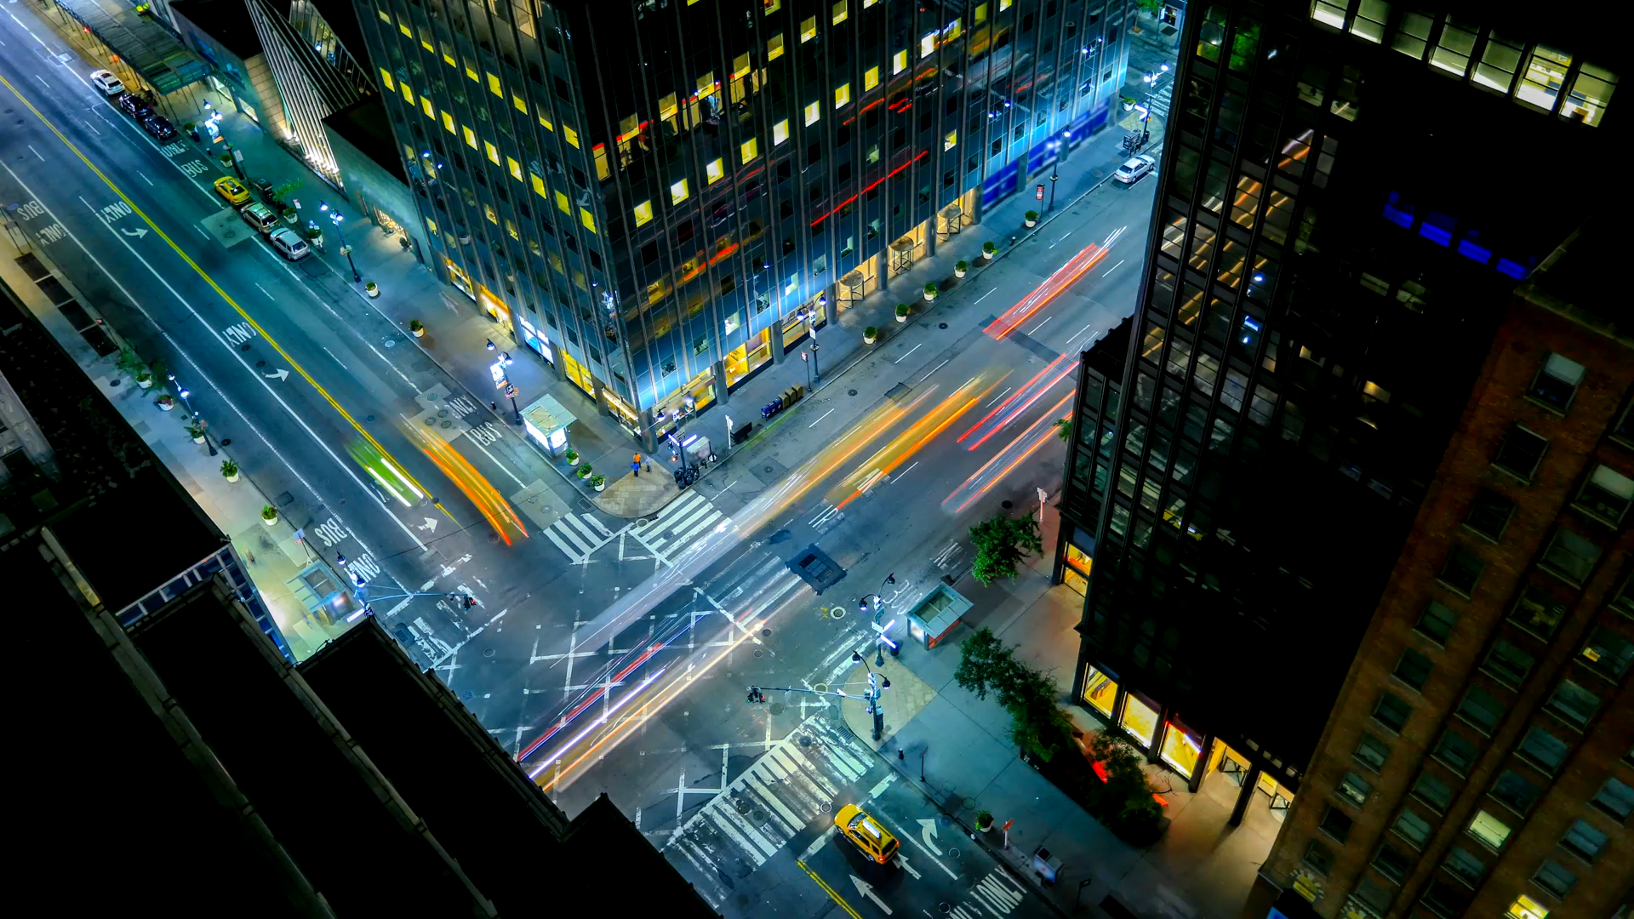
Project:
EasyWay
Subject: CS691
Computer Science
Project 1

Slide 2
Agenda
The objective of this meeting is to understand how we’re tracking towards our deadlines, align on progress, address roadblocks, and sync on the next steps as they pertain to develop.
Discussion on timely submission. Marking the important dates. Add dates to a shared calendar
Discussion on presentation topics and iterative updating the presentation.
Confirm client requirements i.e. Think and study through personas end, what all things can be needed in our project from client’s point of view.
Discuss about the risks.
Interaction, attendance, co-operation, team work, attention from each team member is needed to make the project success.

Slide 3
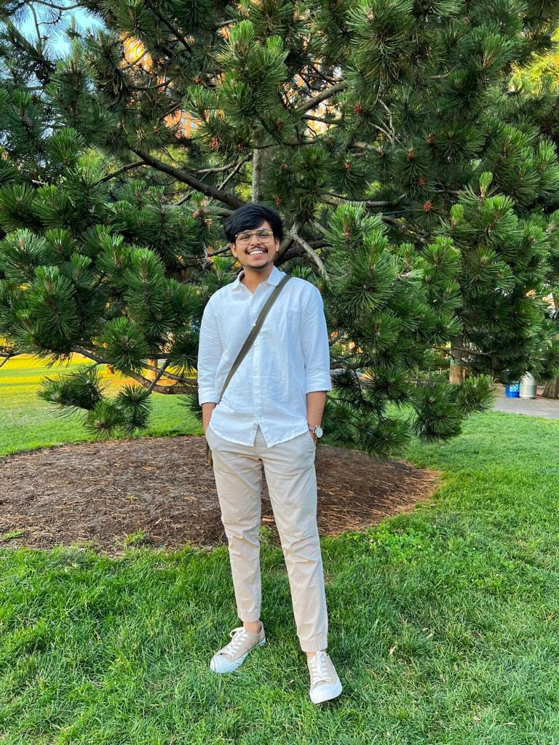
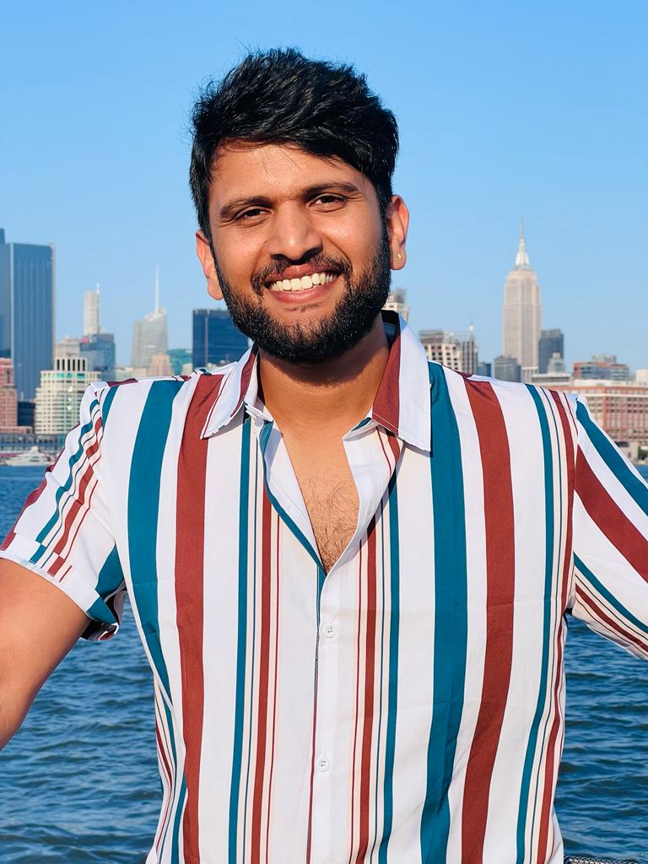
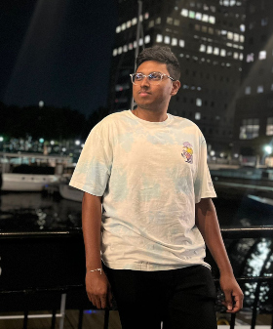
Team Members Roles
Shubham Sawant
Business Analyst & Developer
Aditya Kadarla
Project Manager
Quality Analyst & Tester
Ravi Kumar Dabbada
Database Administrator

Slide 4
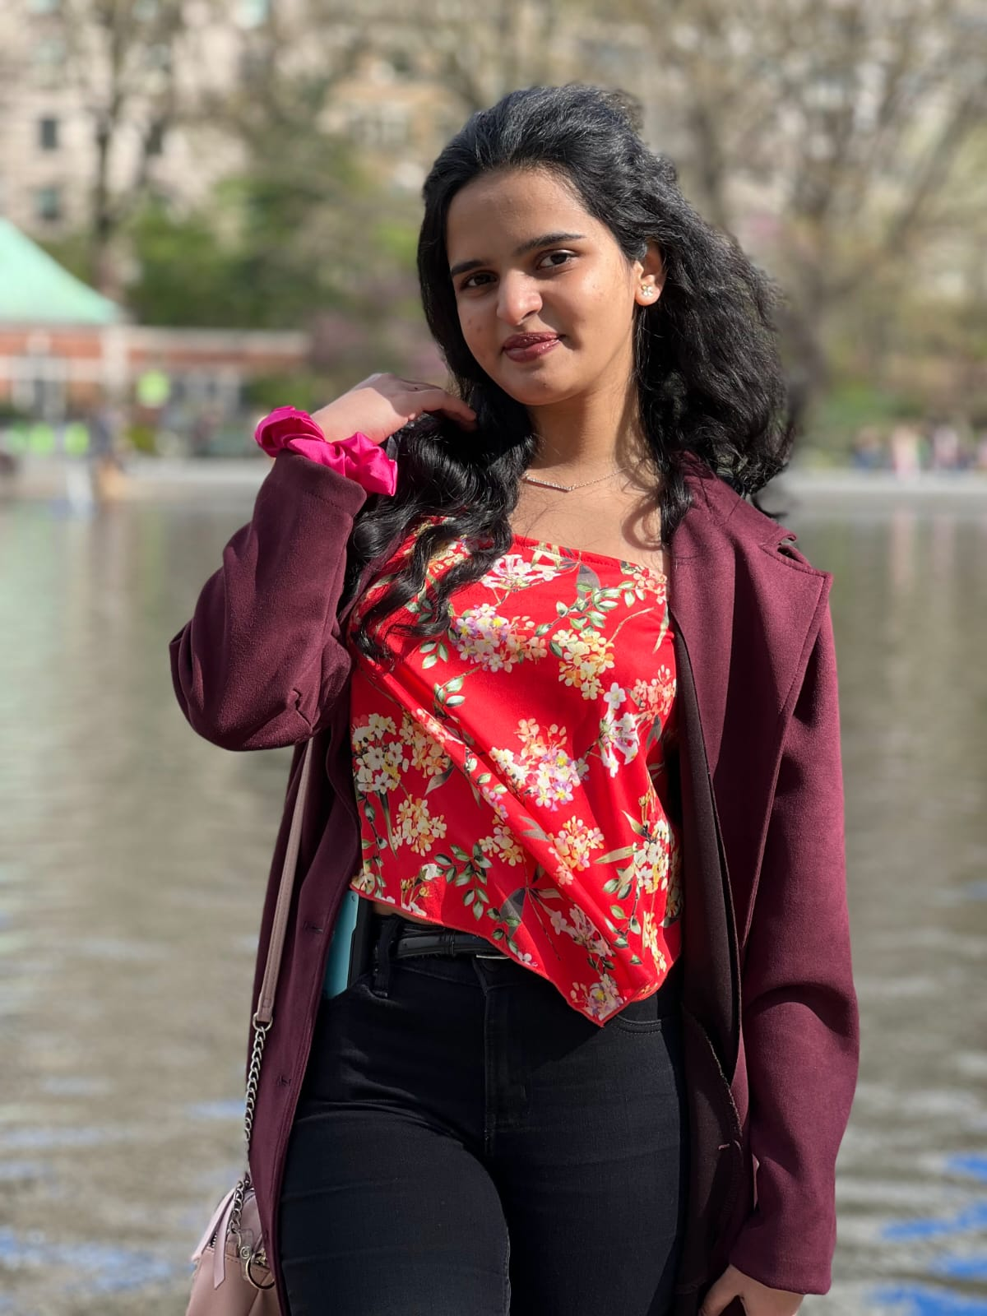
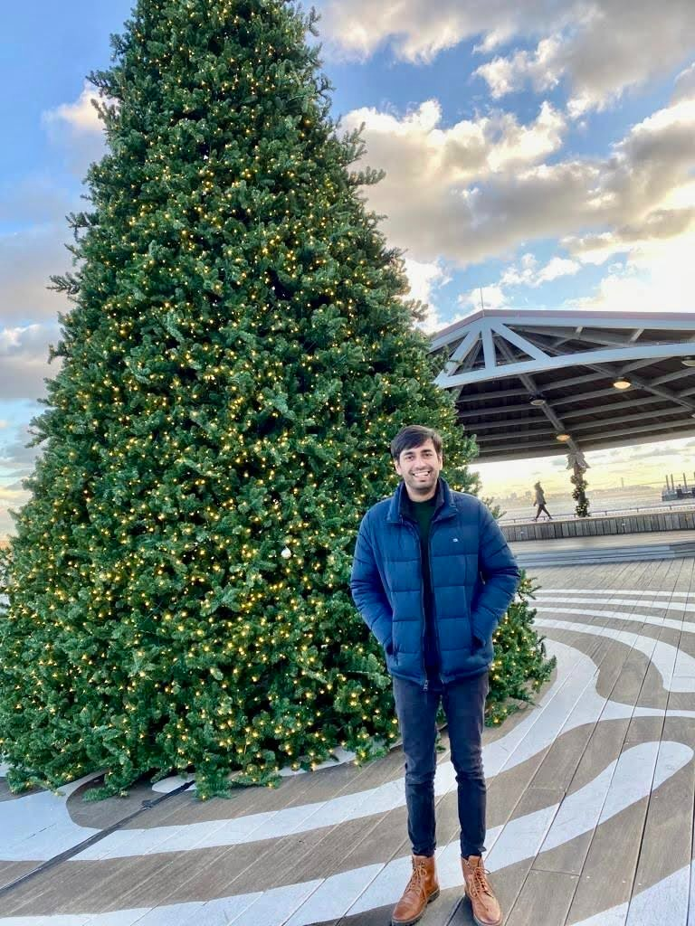
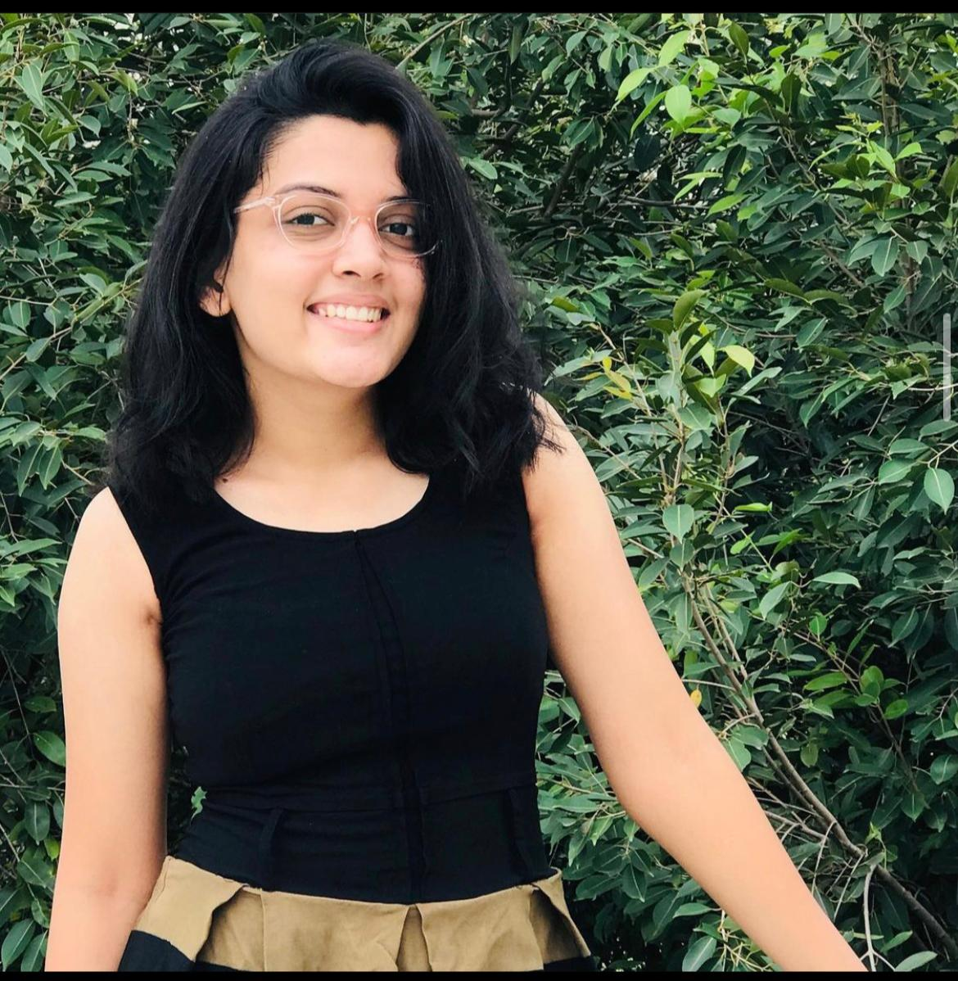
Team Members Roles
Vidisha Vijay Sawant
Developer
Kshitij Sharma
Developer
Femina Baldha
Developer

Slide 5

Problem statement

Slide 6
Problem Statement
Home services are an age-old concept. The “old way” of availing local home services was for servicemen (“handymen”) to market themselves through word of mouth, and then to use listing services such as Yelp. Local home services are inherently disorganized, with individuals usually running business operations. Services range from carpentry, plumbing, beauty, laundry, and so on. Think of anything you need in your home, that can’t be solved by buying a product. That is likely going to be solved by home services.
The trouble is, home services are not a commodity.
The core reason why people continued to rely on word of mouth after bad experiences, was because it was impossible to tell what you were getting into, even for something as “basic” as plumbing. How do you know the carpenter is good, or the plumber will do a good job? Sure, the industry is ripe for disruption, but how would it get disrupted?

Slide 7

project Description

Slide 8
Project Description
The “EasyWay" web application aims to aggregate utility services such as beauty, electrical maintenance, home cleaning, pest control, etc. The application would enable the end-user to select their preferred service, book an appointment at a convenient time, pay the resultant charge and give feedback. The application aims to be a one-stop shop that caters to all the utility needs of the end user. Our product promises easy booking and cancellation without extra changes and you can maintain your booked services in one place easily.

Slide 9
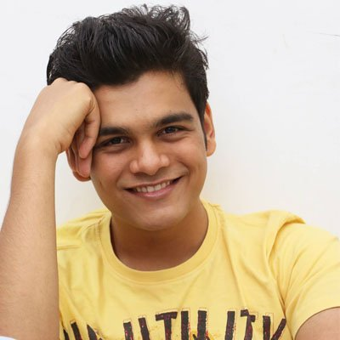
Personas: Sandeep
He is 23 years old. Unmarried, very energetic and a sportsperson. Loves to spend half of his day thinking on body grooming and various fitness ideas. He is very conscious about his looks and body.

Slide 10
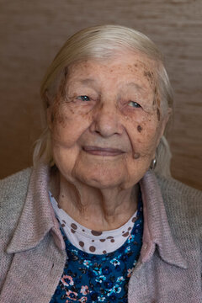
Personas: Lily
She is 76 years of age. Suffering from Asthma, Blood pressure, Diabetes. Lives in Oakland, CA. Can’t drive car due to knee injury. 2 children, out of town for their living. Needs diabetic checkup and medicines, asthma pump on timely manner. Calls ambulance each time whenever needed any medicine. This charges her half of the pension she gets.

Slide 11
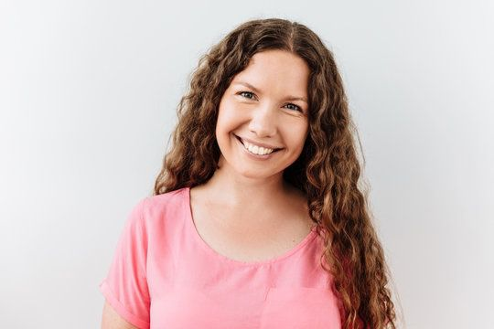
Personas: Amaela
She is a working professional, a housewife and a mother of pretty girl named sara. Stays in New York. Age 30. Hardworking, working in a high-profile job in a MNC company, lot of responsibilities and work. She doesn’t get time to look upon herself. Need a beauty expert to make her glow as an individual in her life. She wants to become a super mommy!

Slide 12
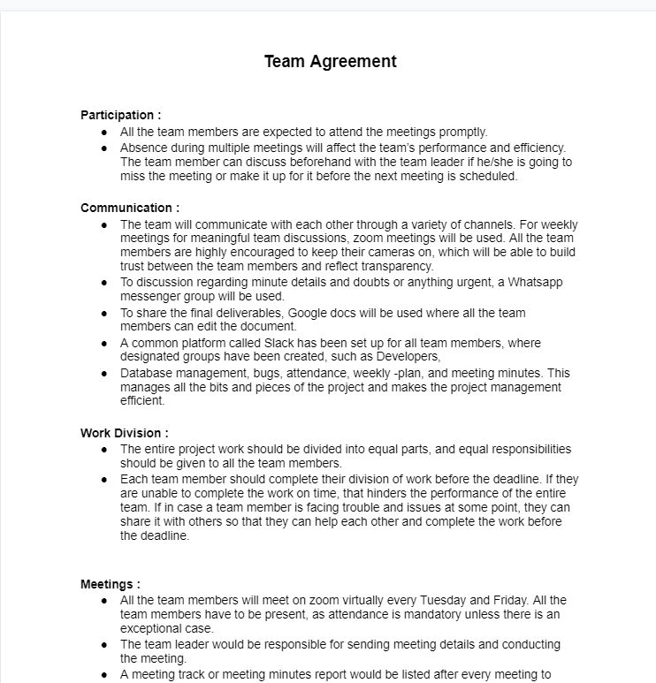
Team Working Agreement
Agreement - Google Docs

Slide 13
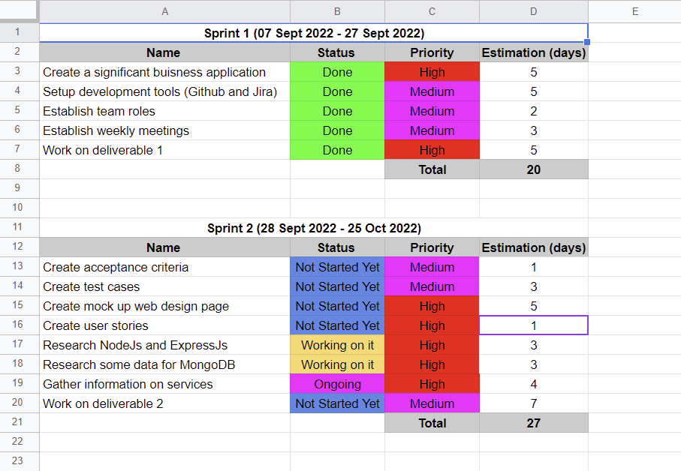
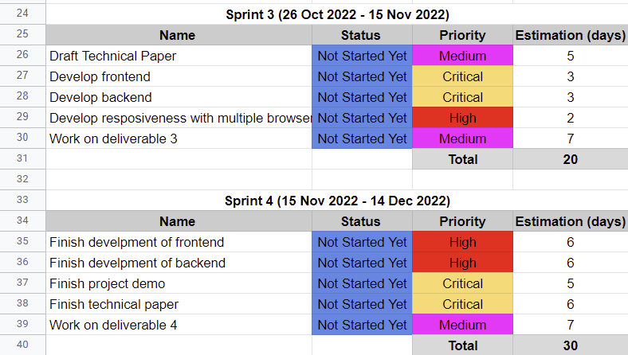
Project Schedule

Slide 14
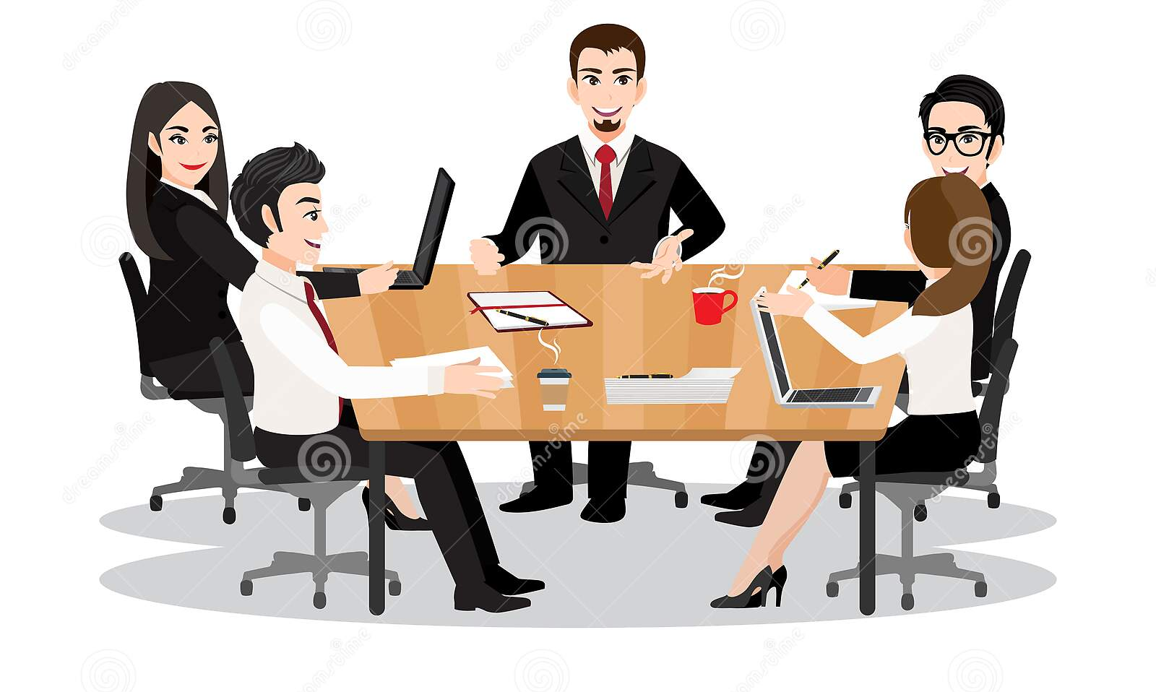
Retrospective

Slide 15
What helped us move forward
Due to communication, we were able to understand the objective well.
Teamwork helped in requirement gathering.
We have listed down the technologies which will be used. Although we still need to learn the concepts in depth to be able to make a good product.

Slide 16
What held us back
Meeting schedules have to be planned carefully.
Team participation requires a slight improvement.

Slide 17
What should we do next
Proper availability of time needs to be discussed.
Get a clear idea of deadlines to finish the tasks as per schedule.
Start working on the activities assigned.

Slide 18
How could we do things differently
We need to use slack workspace more than Whatsapp group chat. So that we can get exposure to how things are been organize in-office conversations and correct applications they use daily.
Helping and motivating each other as a team if some or other in a group lacks some skills/ give them space to learn.

Slide 19
Wiki page Link
https://github.com/ksharma67/EasyWay/wiki

Slide 20
Thank you

